Slide 1
Mind The Wallet
Expense tracking made easy with AI
Nitin Raj Soundararajan
Nagaraj Sengodan
Harsh Bhagwatkar
Prabhu Balan

Slide 2
Fact!
62 % of the employed professionals spend their full monthly salary before it crosses 15 days of a month
56% of the money spent in every month on living expense is under used.
Lack of easy way of tracking bills, receipts from corner shops

Slide 3
Solution
Tracking all the expenses by just taking a photo of the receipt would make it easier for everyone rather than recording expense manually
AI Powered mobile app that scans the receipt would make life easier

Slide 4
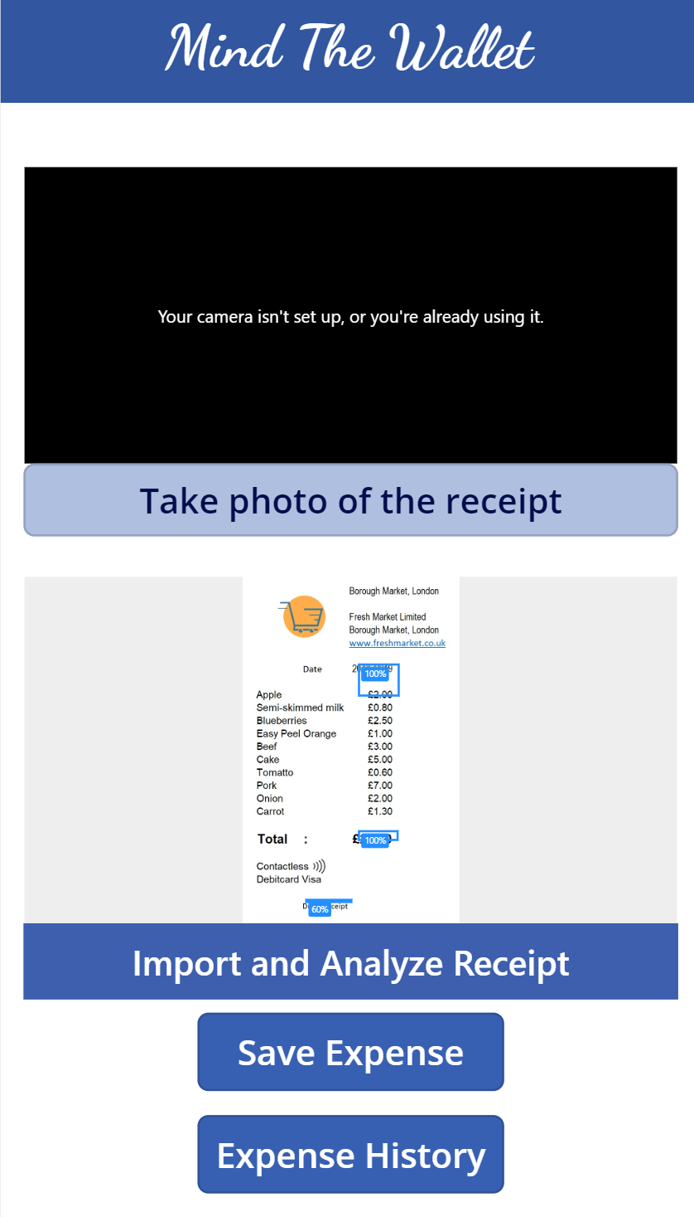
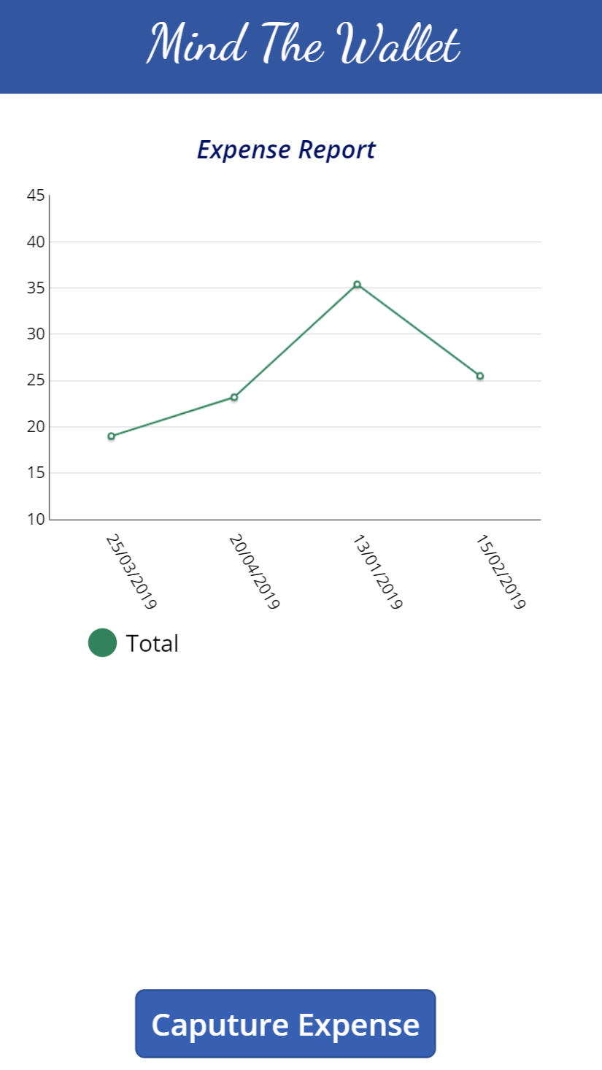
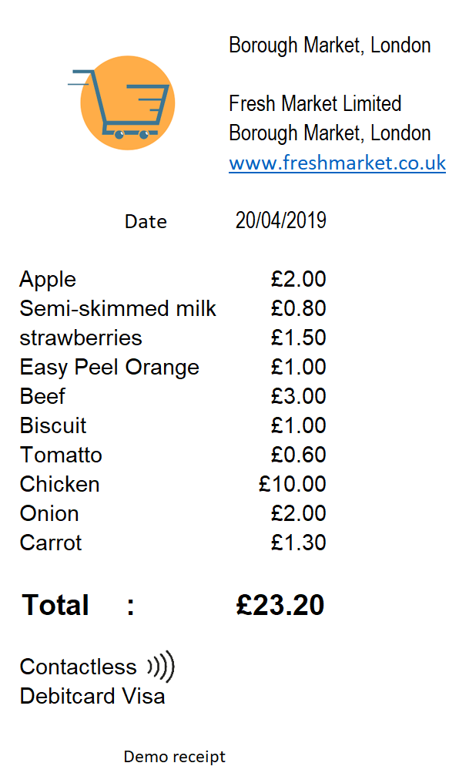
Our Solution – AI Powered Mobile App

Slide 5
Tools and Technologies Used
Microsoft AI
Cognitive Services
Form Recognizer
AI Builder
PowerApp

